Slide 1
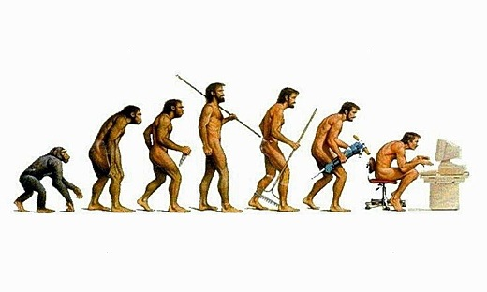
Design Pattern

Slide 2

What ……………...WHY………………????

Slide 3
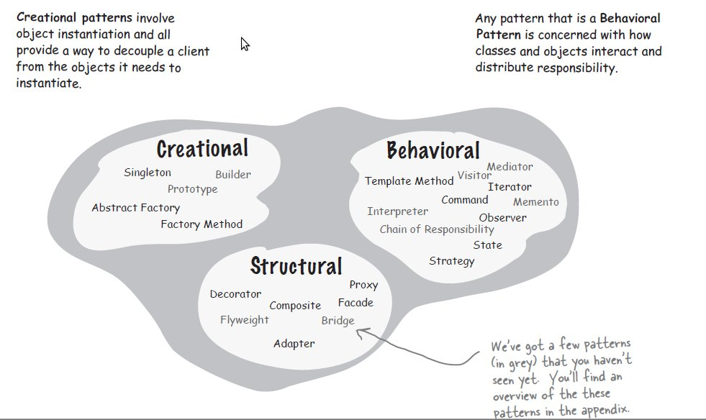
Types of DESIGN pattern

Slide 4
STRATEGY PAttern…………………….BEHAVIORAL PAttern
“GOF Definition”....
Define a family of algorithms, encapsulate each one, and make them interchangeable. Strategy lets the algorithm vary independently from clients that use it
Simplified
“Encapsulate the concept that varies and program to an interface, not an implementation.”

Slide 5



Traveling From A-->B
Source A
Weather
Condition-
Context
Destionation B

Slide 6
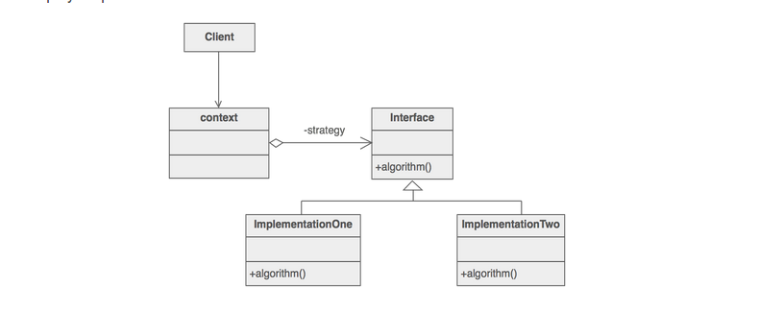
UML - Strategy
The Strategy pattern lets you build software as a loosely coupled collection of interchangeable parts

Slide 7
STEPS
Implement a Strategy interface for your strategy objects
Implement ConcreteStrategy classes that implement the Strategy interface, as appropriate
In your Context class, maintain a private reference to a Strategy object.
In your Context class, implement public setter and getter methods for the Strategy object

Slide 8
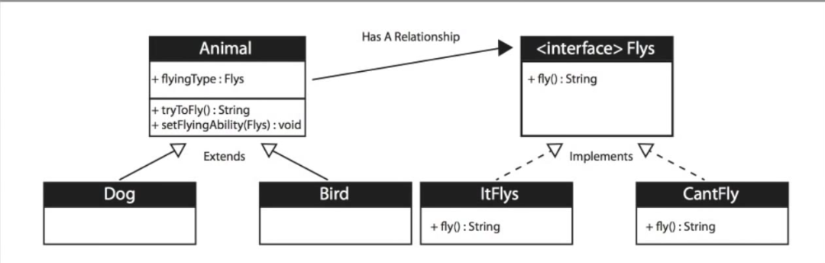
Example

Slide 9
Example
Payment GateWay option in payments
Validation algorithm
Network request response formation as per USER AGENT
Applying encryption as per requirement

Slide 10
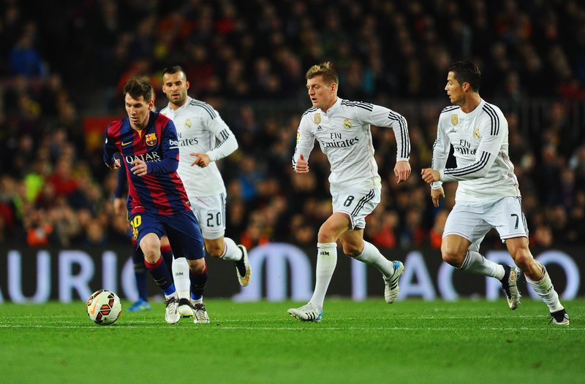
IDENTIFY NExt DESIGN PATTERN………………!!!!!!!!??????????

Slide 11
Singleton DEsign Pattern(CREATIONAL)
This pattern involves a single class which is responsible to create an object while making sure that only single object gets created.
This class provides a way to access its only object which can be accessed directly without instantiating the object of the class.

Slide 12
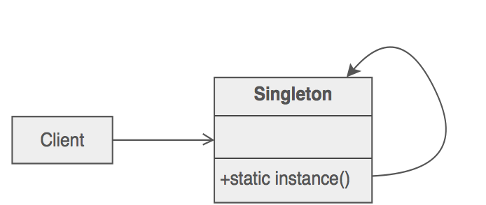
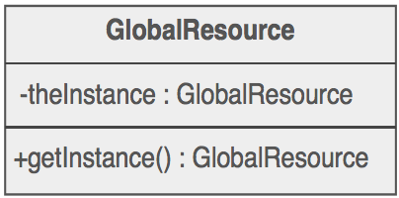
UML

Slide 13
HOW TO create Singleton class
public class SingletonDemo {
private SingletonDemo() { }
public static SingletonDemo getInstance() {
if (instance == null ) {
instance = new SingletonDemo();
}
return instance;
}
}

Slide 14
Ways to DEFINE SINGLETON PATTERN
Synchronized getInstance
Double check Locking
Defining static singleton class variable(Volatile)
Holder class
Using static block inside class

Slide 15
SINGLETON Pattern violation…...
Reflection
Serialization/Deserialization
cloning
Multi threaded access
Multi class loaders
Garbage collection

Slide 16
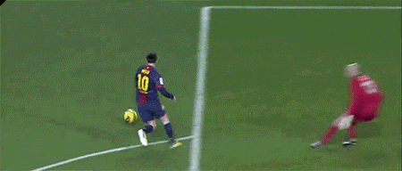
Race condition

Slide 17
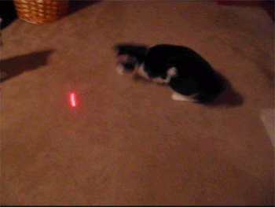
Keep ON Looking

Slide 18
EXAMPLE
Runtime class in Java.
Logger to print logs.
Image Loader in Android
Database operation….ORMLite

Slide 19

On Completion of Work Successfully

Slide 20

In case of Failure

Slide 21
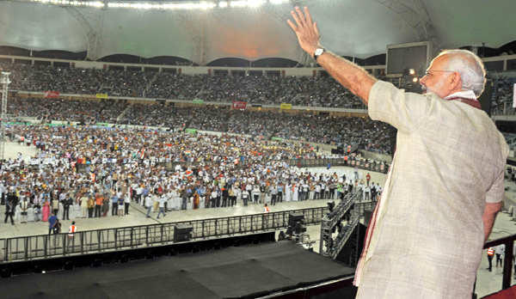
Can you predict this Design Pattern….??????

Slide 22



Observer Pattern

Slide 23
PRINCIPLE
Observer pattern is used when there is one-to-many relationship between objects such as if one object is modified, its dependent objects are to be notified automatically…...

Slide 24
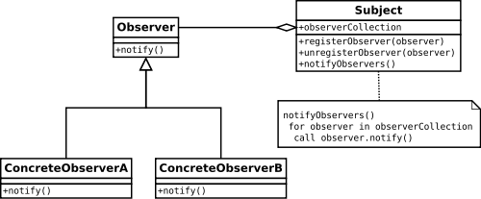
UML

Slide 25
PUSH & PULL Mechanism
PUSH…………….
The subjects send detailed information about the change to the observer whether it uses it or not.
PULL
The subject just notifies the observers when a change in his state appears and it's the responsibility of each observer to pull the required data from the subject.

Slide 26

PULL Mechanism example

Slide 27
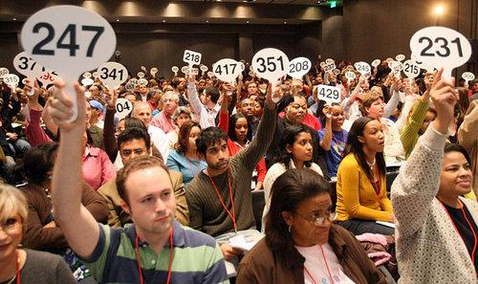
PULL MECHANISM

Slide 28
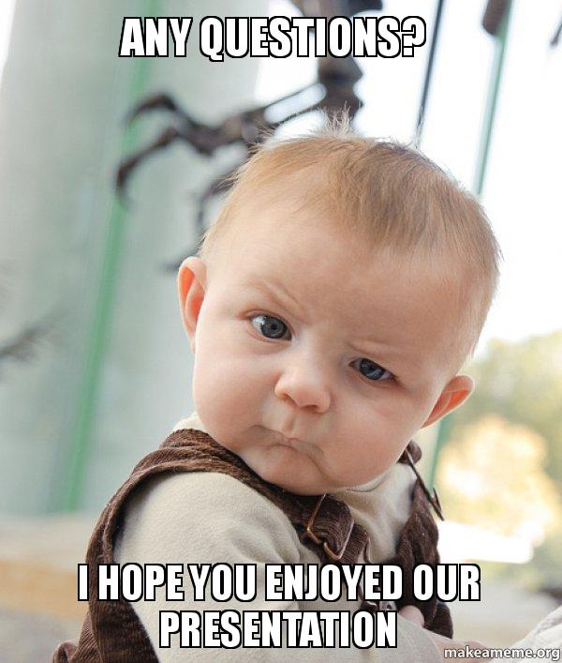

Slide 29
OOP Principles
Encapsulate that varies
Favor composition over inheritance
Program to interface,not implementation
Strive for loosely coupled design between objects
Classes should be open for extension,Closed for modification
Depend on Abstraction,Don't Depend on Concrete class
maximize cohesion and minimize coupling

